Slide 1
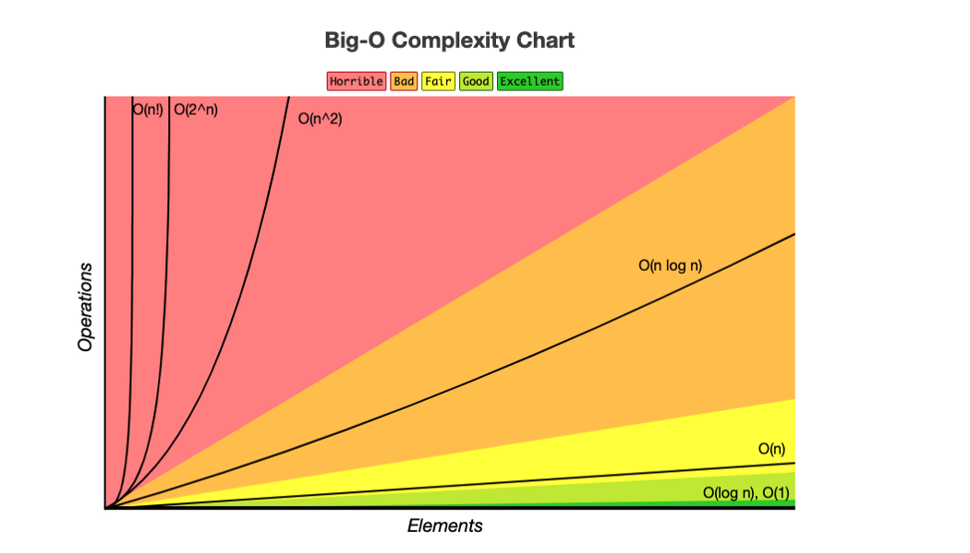
source: https://www.bigocheatsheet.com/

